Slide 1



Concurrency
( Part 1)

Slide 2
Objectives
Thread Fundamentals
  What a Thread Executes
  When Execution Ends
  Thread States
  Thread Priorities
  Daemon Threads
Controlling Threads
  Yielding
  Suspending
  Sleeping
  Blocking
  Monitor States (next Session)

Slide 3
Threads
Making a single JVM look like many machines, all running at the same time.
A single-threaded Java program:
  one entry point (main method)
  one exit point
  all instructions are run serially
A multithreaded program:
  first entry point (main method)
  followed by multiple entry and exit points for other methods that run concurrently with the main() method.

Slide 4
What is Thread for?
Threads are valuable tools for allowing unrelated, loosely related, or tightly related work to be programmed separately and executed concurrently.

Slide 5
Thread Fundamentals
Java’s thread support resides in three places:
  The java.lang.Thread class
  The java.lang.Object class
  The Java language and JVM

Slide 6
Thread Fundamentals…
Thread is the smallest unit of executable code that performs a particular task.
An application can be divided into multiple tasks and each task can be assigned to a thread.
Many threads executing simultaneously is termed as Multithreading.
Appears that threads are running concurrently, but it is not so.

Slide 7
Multitasking Vs Multithreading
Multitasking is the ability to run one or more programs concurrently.
  Operating system controls the way in which these programs run by scheduling them.
  Time elapsed between switching of programs is minuscule.
Multithreading is the ability to execute different parts of a program called threads, simultaneously.

Slide 8
Creating threads
When Java programs execute, there is always one thread running and that is the main thread.
  It is the thread from which child threads are created.
  Program is terminated when main thread stops execution.
  Main thread can be controlled through Thread objects.
  Reference of the main thread can be obtained by calling the currentThread() method of the Thread class.

Slide 9
Creating threads…
Thread objects can be created in two ways:
  Declare a class that is a sub-class of the class Thread then define your run() method.
  Declare a class that implements the Runnable interface then define your run() method in that class.

Slide 10
What a Thread Executes
To make a thread execute, you call its start() method (registers the thread with the thread scheduler).
The scheduler determines which thread is running on each available CPU at any given time.

Slide 11
When Execution Ends
The run() method returns

Slide 12
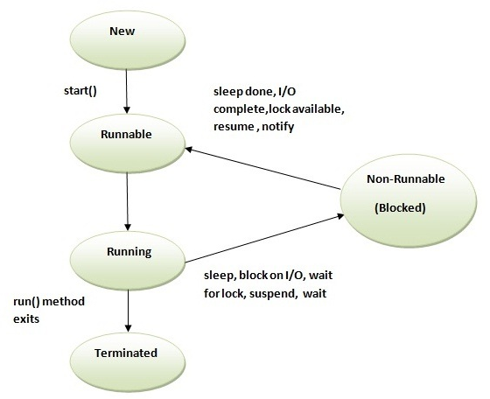
Thread States
When you call start() on a thread, the thread does not run immediately. It goes into a “ready-to-run” state and stays there until the scheduler moves it to the “running” state. Then the run() method is called.

Slide 13
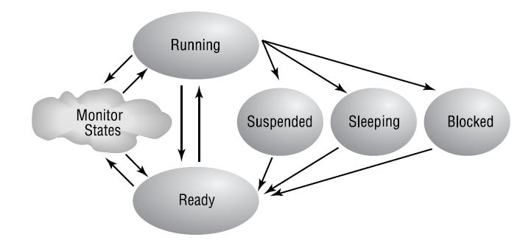
Thread States…
Living States
The methods associated with the Suspended state are now deprecated
The mechanism that Java uses to support synchronization is the monitor.

Slide 14
Thread States…
Dead State
The thread has finished its task and is considered dead.
  You can’t restart a dead thread by calling its start() or run() methods.
  You can call other methods (besides start() and run()) of a dead thread.

Slide 15
Thread Priorities
Every thread has a priority, which is an integer from 1 to 10.
Threads with higher priority should get preference over threads with lower priority.
The default priority is 5, but all newly created threads have their priority set to that of the creating thread.

Slide 16
Thread Priorities…
Changing thread priorities:
  setPriority() method
  getPriority() method

Slide 17
Daemon Threads
Daemon threads are infrastructure threads, created automatically by the JVM.
When an application begins to run, there is only one non-daemon thread in existence: the main thread.
Any threads created by daemon threads are initially daemon threads.
Threads created by non-daemon threads are initially non-daemon threads.
Before a thread begins execution, you can change its daemon status by calling its setDaemon() method.
The JVM runs until the only live threads are daemons.

Slide 18
Controlling Threads
Thread control is the art of moving threads from state to state.
  Yielding
  (When a thread executes a thread yield, the executing thread is suspended and the CPU is given to some other runnable thread. This thread will wait until the CPU becomes available again. )
  Suspending and then resuming
  Sleeping and then waking up
  Blocking and then continuing
  Waiting and then being notified (next session)

Slide 19
Yielding
A call to the static yield() method of Thread.
Cause the currently executing thread to move to the Ready state
The scheduler may run any other thread in place of the yielding thread.

Slide 20
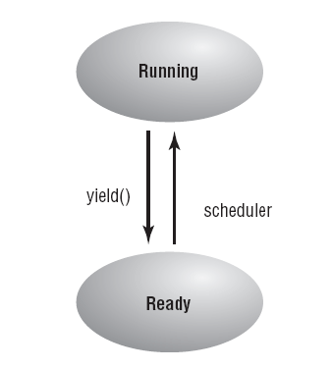
Yielding…
private void traceRays() {
for (int j = 0; j < 300; j++) {
for (int i = 0; i < 300; i++) {
computeOnePixel(i, j);
Thread.yield();
}
}
}

Slide 21
Suspending
Suspending a thread is a mechanism that allows any arbitrary thread to make another thread unready for an indefinite period of time.
The suspended thread becomes ready when some other thread resumes it.
The suspend() and resume() methods are deprecated as of the Java 2 release. The exact effect of suspend() and resume() is much better implemented using wait() and notify().

Slide 22
Sleeping
A sleeping thread passes time without doing anything and without using the CPU.
sleep() method:
public static void sleep(long milliseconds) throws InterruptedException
public static void sleep(long milliseconds, int nanoseconds) throws InterruptedException

Slide 23
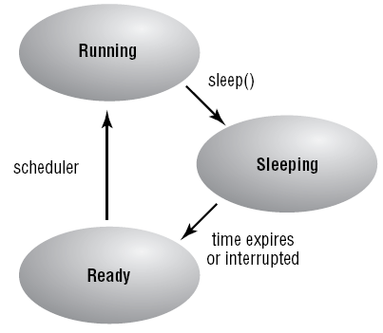
Sleeping…
A sleeping thread that receives an interrupt() call moves immediately into the Ready state; when it gets to run, it will execute its InterruptedException handler.

Slide 24
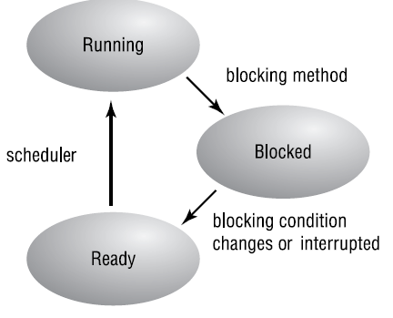
Blocking
Some methods have to wait for some occurrence in the outside world before they can proceed.
This behavior is known as blocking.

Slide 25
Monitor States
Study in the next Session

Slide 26
Summary
Thread Fundamentals
  What a Thread Executes
  When Execution Ends
  Thread States
  Thread Priorities
  Daemon Threads
Controlling Threads
  Yielding
  Suspending
  Sleeping
  Blocking
  Monitor States (next Session)
Q&A

Slide 27
Thread States
+ NEW : thread chưa được khởi hoạt.
+ RUNNABLE : thread đang hoạt động trong JVM.
+ BLOCKED : thread chờ một monitor để unlock một đối tượng mà nó cần.
+ WAITING : thread chờ không giới hạn cho đến khi một thread khác đánh thức nó.
+ TIMED_WAITING : thread chờ trong một thời gian nhất định, hoặc là có một thread khác đánh thức nó.
+ TERMINATED : thread đã kết thúc công việc của nó.

